Slide 1

Traffic Signal Classification
User Manual
Author: Pravit Santhosh
Notes:
Preworks course home assignments

Slide 2
Table of Contents
Acknowledgements
About Me
About My Internship Journey with Clevered
About App
How do I use the app
Option Name
Contact Me

Slide 3
Acknowledgements
I would like to express my appreciation and gratitude to all who have helped me on this journey of this internship. I am thankful to my mentor Mr.Avishek Das clears the doubt whenever i have.I am thankful for the support that my parents had given me. Finally, I'd like to convey my gratitude for the amazing opportunity to intern under the renowned Mr. Ken Khan.

Slide 4
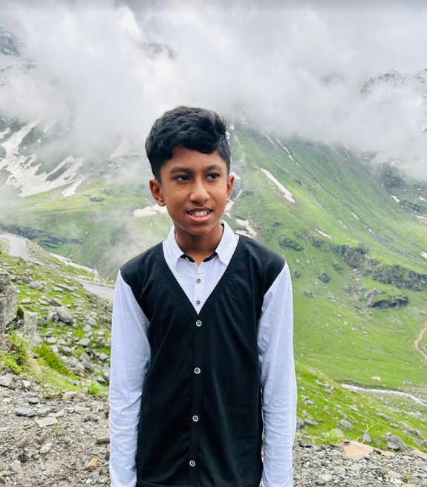
About Me..
My name is Pravit Santhosh and I was born on 5th May 2010 and I am 13 years old.I am born on India and I am currently in Dubai.My hobbies are to play chess,cricket and computers.I am currently in AI developer Level 2

Slide 5
About My Internship Journey with Clevered
My internship journey has been really fun and interesting.Avishek Sir who puts the hardwork and dedicated to his students day and night to complete everyone’s project to ensure none of the projects remains incomplete.I am grateful and thankful and I am looking forward to learn more.

Slide 6
About App..
The app is Traffic Sign Classifier.When you go on the road, you see various traffic signs like traffic signals, turn left or right, speed limits, no passing of heavy vehicles, no entry, children crossing, etc. that you need to follow for a safe drive. Likewise, autonomous vehicles also have to interpret these signs and make decisions to achieve accuracy. The method of recognizing which class a traffic sign belongs to is called Traffic signal classification.The reason for choosing this project is to prevent more accidents and injuries.It is also beneficial for society as there is road safety and it helps visually impaired people and it will reduce human errors.

Slide 7
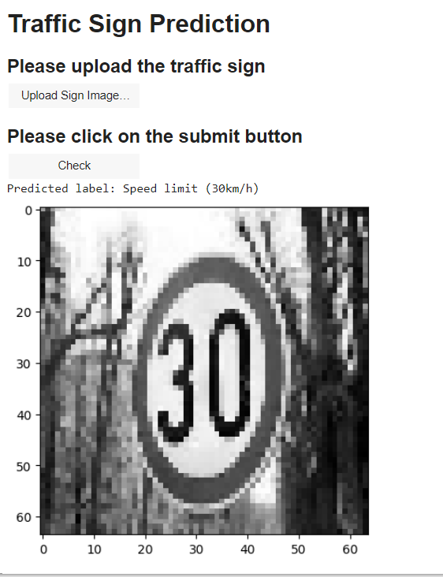
Option Name(This will be repeated for each option of the App)
So first I click the button upload sign image and then I put one image and then i check and then result will come of the speed limit and the image will be shown

Slide 8
Contact Person
Please contact me at pravitsuma@gmail.com

Slide 9
Thank you!

